Slide 1
Intro to Computer Science
Day 12

Slide 2
Traversal and the for loop by index
Iteration allows you to go through characters in a string You can also use the range function to systematically generate the indices of the characters
The index positions in “apple” are 0,1,2,3 and 4 the same as returned by range(5).
To make the iteration more general, we can use the len function to provide the bound for range
Example: forByRange.py, forLen.py, forMod.py

Slide 3
You can use while to iterate through a loop
However remember you are responsible for an exit condition or your program can hang
How many times will o be printed?
s = "python rocks"
idx = 1
while idx < len(s):
print(s[idx])
idx = idx + 2
Example:whileString.py

Slide 4
The in and not in operators
Lets you test if a substring is in or not in a string
Note that a string is a substring of itself, and the empty string is a substring of any other string
The not in operator returns the logical opposite result of in
Example inNot.py

Slide 5
The Accumulator Pattern with Strings
Combining the in operator with string concatenation using + and the accumulator pattern, we can write a function that removes all the vowels from a string.
Remember that the accumulator pattern allows us to keep a “running total”. With strings, we are not accumulating a numeric total. Instead we are accumulating characters onto a string.
You can also use and to test if two things are true or false
Example removeVowel.py, logicalAnd.py

Slide 6
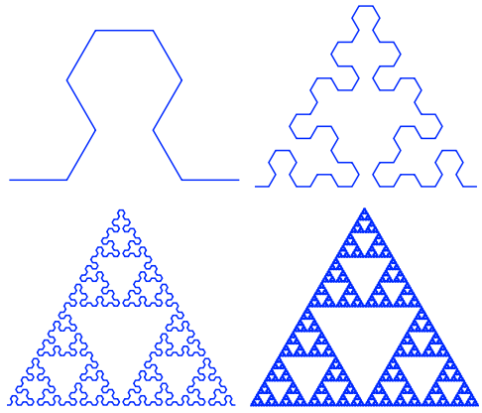
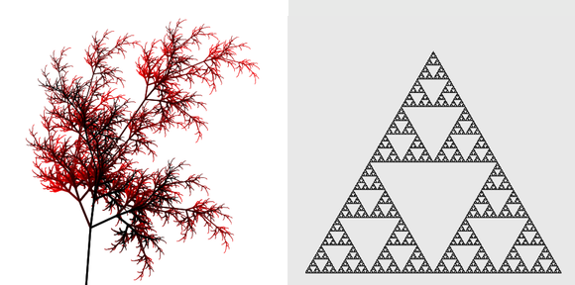
Turtles and Strings and L-Systems

Slide 7
L systems are replacement systems
You input a string and there are two replacement rules.
A Axiom
A -> B Rule 1 Change A to B
B -> AB Rule 2 Change B to AB
left hand side -> right hand side
A
B Apply Rule 1 (A is replaced by B)
AB Apply Rule 2 (B is replaced by AB)
BAB Apply Rule 1 to A then Rule 2 to B
ABBAB Apply Rule 2 to B, Rule 1 to A, and Rule 2 to B

Slide 8
Lsystems
Rules are very much like if statements.
We are going to start with a string and iterate over each of its characters.
As we apply the rules to one string we leave that string alone and create a brand new string using the accumulator pattern. When we are all done with the original we replace it with the new string.
example: lsys.py

Slide 9
The famous Lindmeyer system
Now lets look at a real L-system that implements a famous drawing. This L-system has just two rules:
F Axiom
F -> F-F++F-F Rule 1
This L-system uses symbols that will have special meaning when we use them later with the turtle to draw a picture.
F Go forward by some number of units
B Go backward by some number of units
- Turn left by some degrees
+ Turn right by some degrees
Example: turtleL.py

Slide 10
Looping And Counting
a few more examples that show variations on the theme of iteration through the characters of a string. We will implement a few of the methods that we described earlier to show how they can be done.
Find lets you find a match in a string
It can take an optional 3rd parameter, a number from which to start after
Exmaple:countLetter.py, findLetter.py, findThird.py

Slide 11
Homework
Review the last 4 slides and try all code samples
Play with different kinds of L-systems. Create at least 3 different rule variations that output 3 variants of this drawing.

